Slide 1
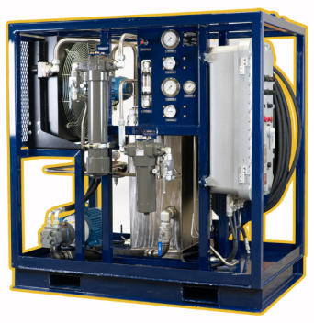

Rotating Control Devices
Technical Sheet
RCD Bearing Cooler Unit
The RCD Bearing Cooler Unit is customed designed to work with ARES 3078 and ARES 3090 Bearing Assemblies. The cooling unit utilizes a hydraulic pump and electric cooling fan to continuously pump cooled bearing oil through the Bearing Assembly during operations. Cooling the equipment allows longer operating times and extends the overall Bearing Assembly life in high temperature environments and applications as well as sustained high RPM use.
Applications
  Managed Pressure Drilling
  Underbalanced Drilling
  Pressurized Mud Cap Drilling
  Extended Reach well
  Geothermal wells
  High Temperature Environments
  High RPM
Features
  Compatible with all ARES 3078 and 3090 Bearing Assemblies
  Forklift pockets and top lifting lugs for optimal handling
  Automatic circulating pump and cooling fan
  10 HP Electric Motor
  2 HP Electric cooler fan
  Class 1 Div 2 Electrical Rating, Zone I and ATEX options available
  100 ft electrical cables
  21.7 GPM Tandem Gear Hydraulic Pump
  2 X 100 ft., 5000 psi hydraulic hoses for supply (⅝ in.) and return (¾ in.)
  RCD Circulation and Cooler Circulation pressure relief valves
  Automatic oil level monitoring with high- and low-level shutdown and isolation
  Visual filter indication
  Simple control panel with power switch, emergency stop, and manual override for cooler functions
RCD Bearing Cooler Unit

Slide 2
Rotating Control Devices
Technical Sheet
RCD Bearing Cooler Unit
Specifications
General Data
Dimensions (L x W x H) | 1.8 m x 1.2 m x 1.8 m (70 in. x 48 in x 72 in)
Estimated Dry Weight | 1361 kg (3000 lb.)
Estimated Wet Weight | 1588 kg (3500 lb.)
Reservoir Capacity | 170.3 L (45 US gal)
Cooler Circulation Pressure Relief | 1379 kPa (200 psi)
RCD Circulation Pressure Relief | 1724 kPa (250 psi)
Electrical Rating | Class 1 Division 2
Power Source | 230/380/460V 3-Phase 50/60Hz
Hydraulic Pump – Tandem Gear
Lubricant Type | ISO 320 Synthetic Gear Oil
Heat Exchanger Circuit Pump Displacement | 36 cc/rev (2.17 in³/rev)
Maximum Flow | 64 L/min (16.9 GPM)
Bearing Lubricating Circuit Pump Displacement | 10 cc/rev (0.62 in³/rev)
Maximum Flow | 18.2 L/min (4.8 GPM)

